Slide 1
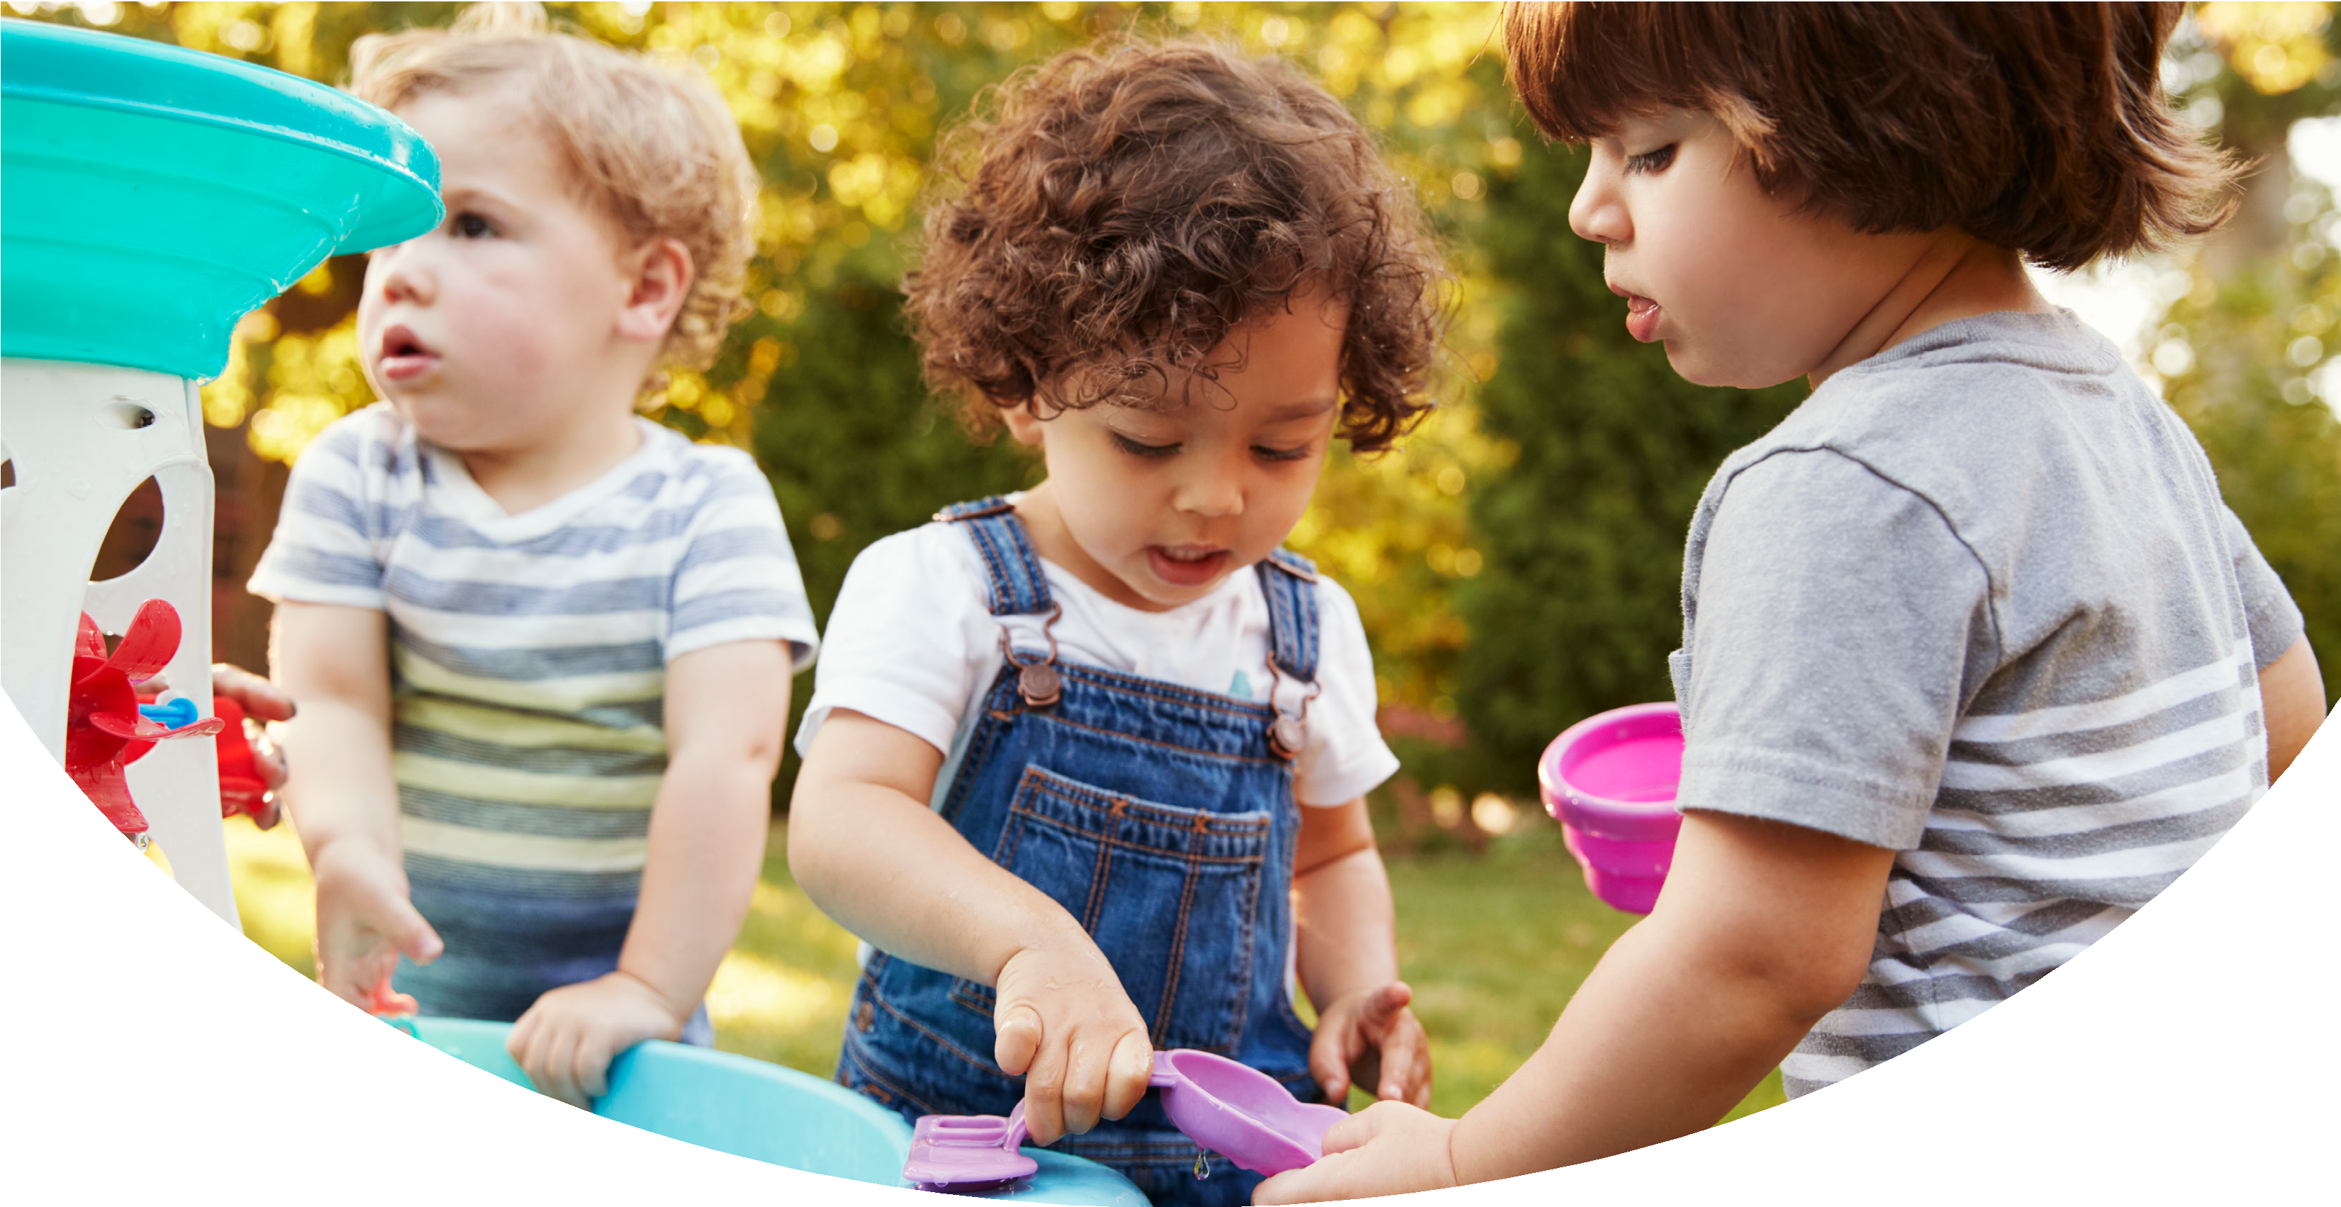



Going Back to Child Care
Written to support children’s re-entry to care after sheltering at home. The reproduction of this document is encouraged. Permission to copy is not required and it may be modified to meet your needs. Special thanks to Jen Gerdes, Holly Hatton-Bowers, Lynne Brehm, and Sami Bradley for their contributions in this story.

Slide 2
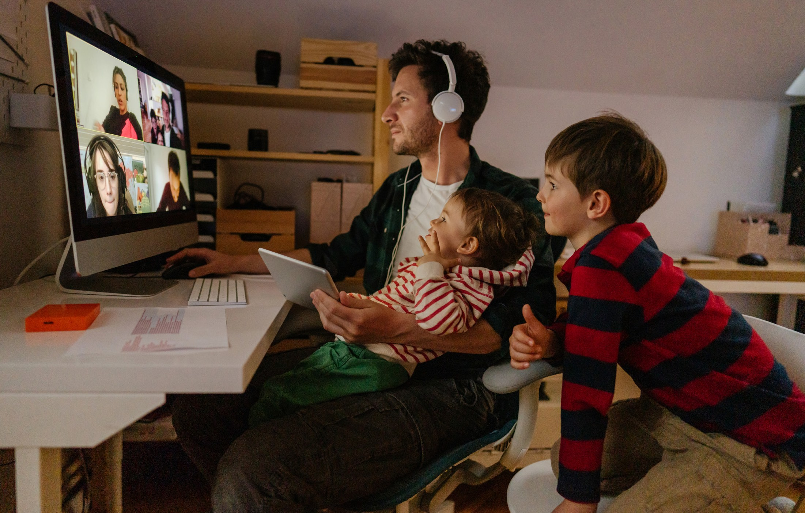
My family and I have been staying home to help keep people safe and healthy.
I get to go back to child care soon.

Slide 3
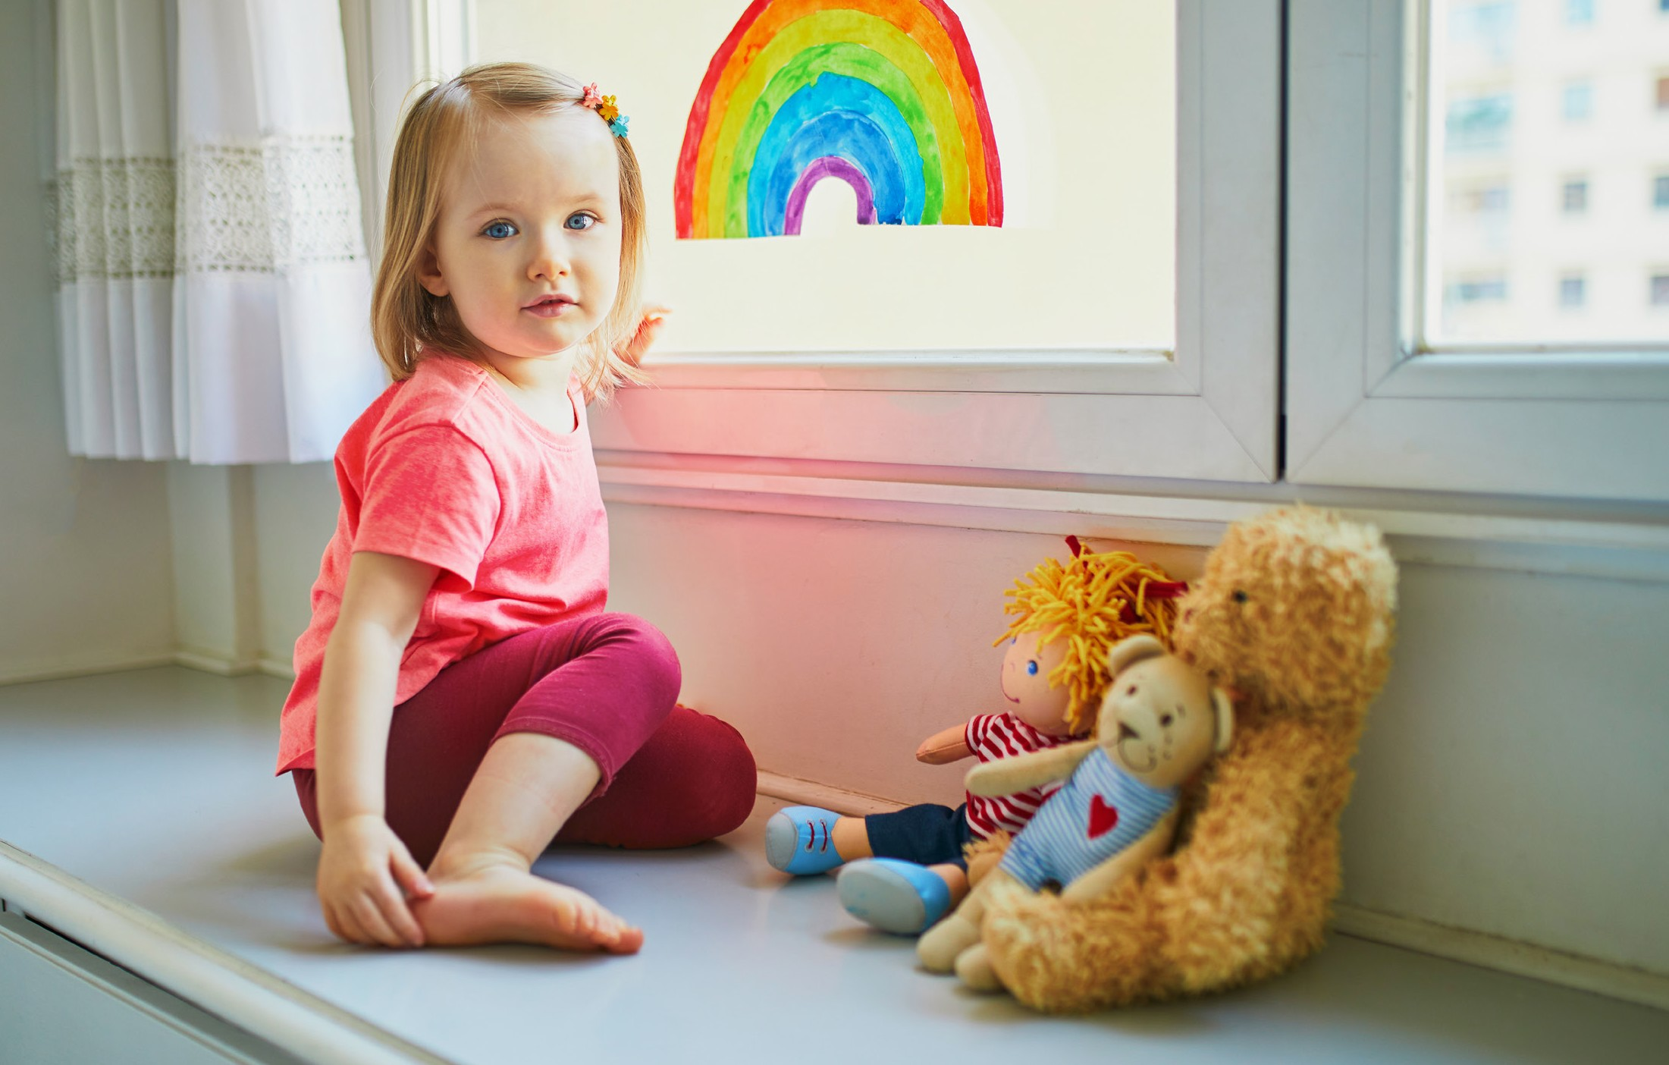
I feel a lot of big feelings about going back to
child care.
Sometimes I feel excited, nervous, scared, sad, and happy. Sometimes I feel all of these feelings at the same time.

Slide 4
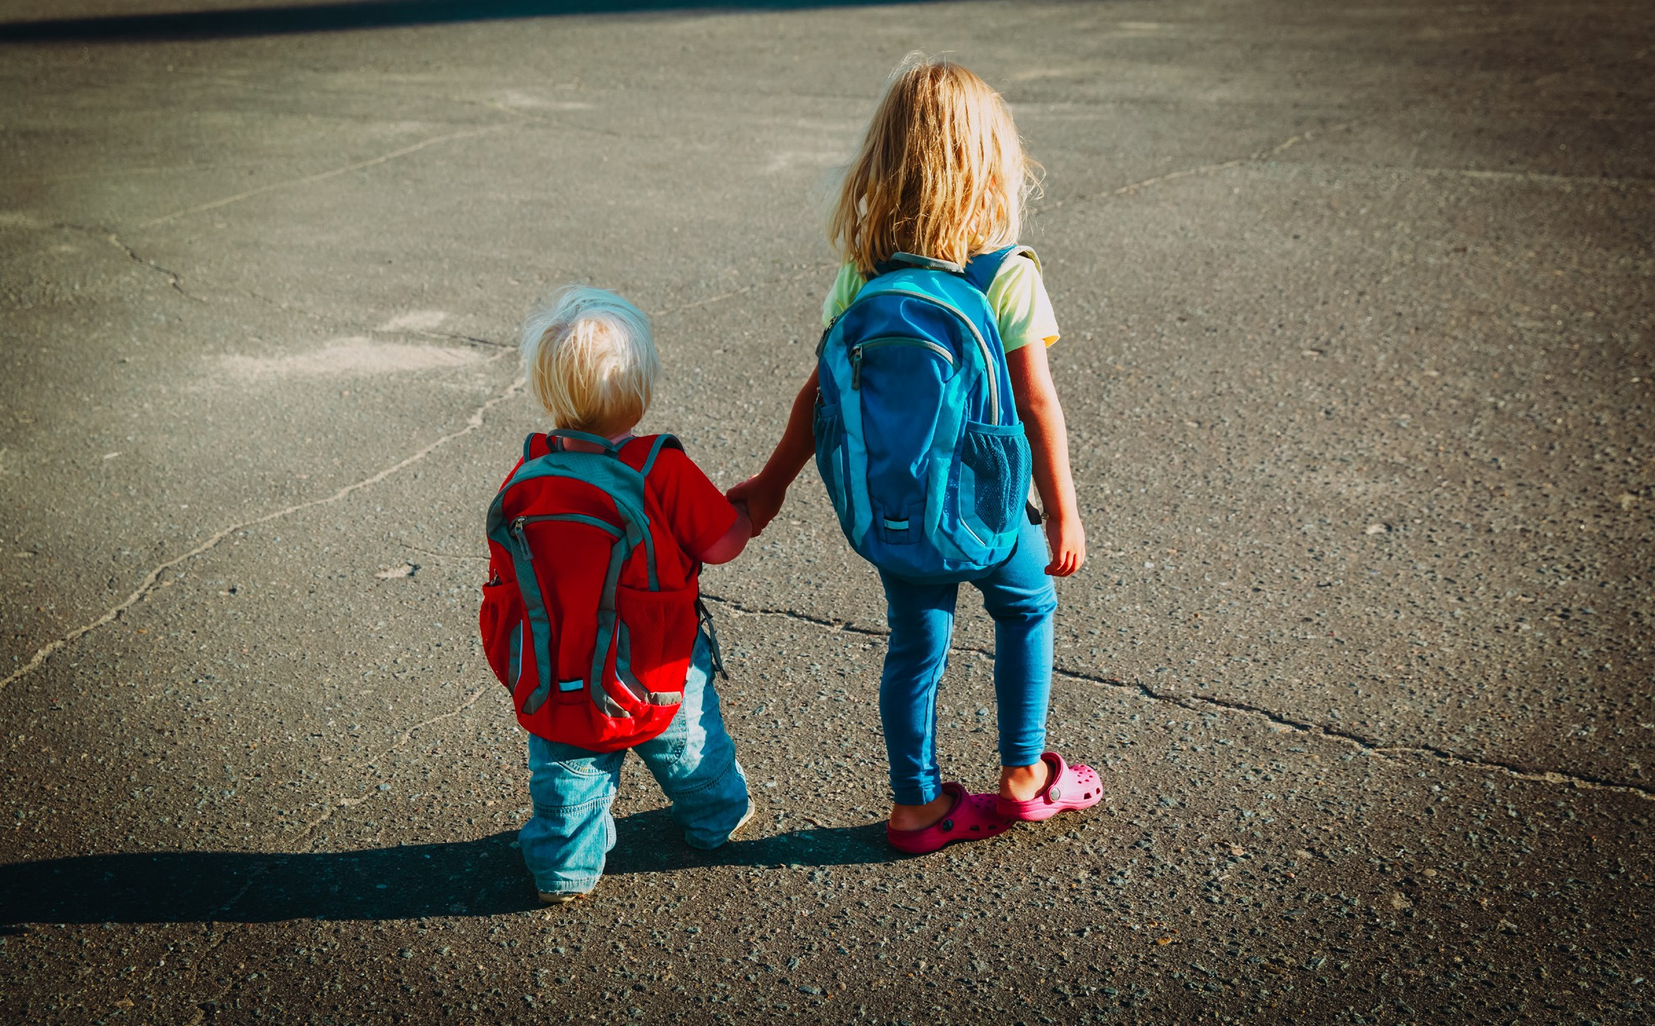
When I go back to child care, there will be some different ways we do things to help keep us safe and healthy.

Slide 5
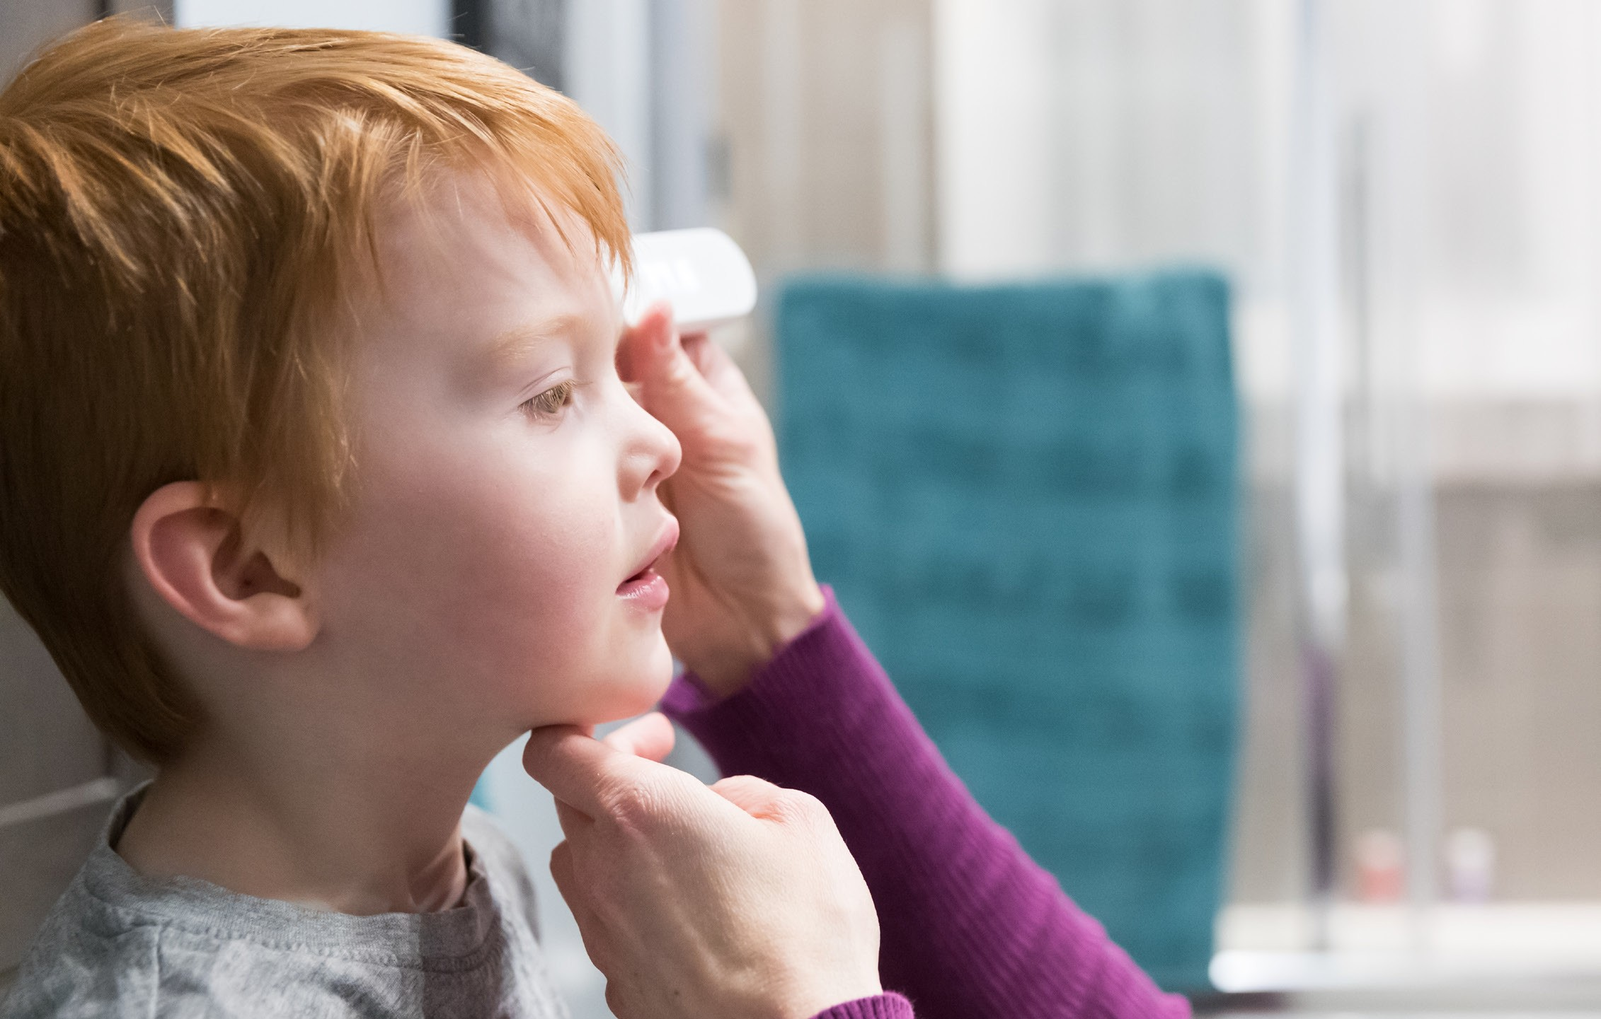
I might have my temperature taken each day.
This is to make sure I’m healthy.

Slide 6
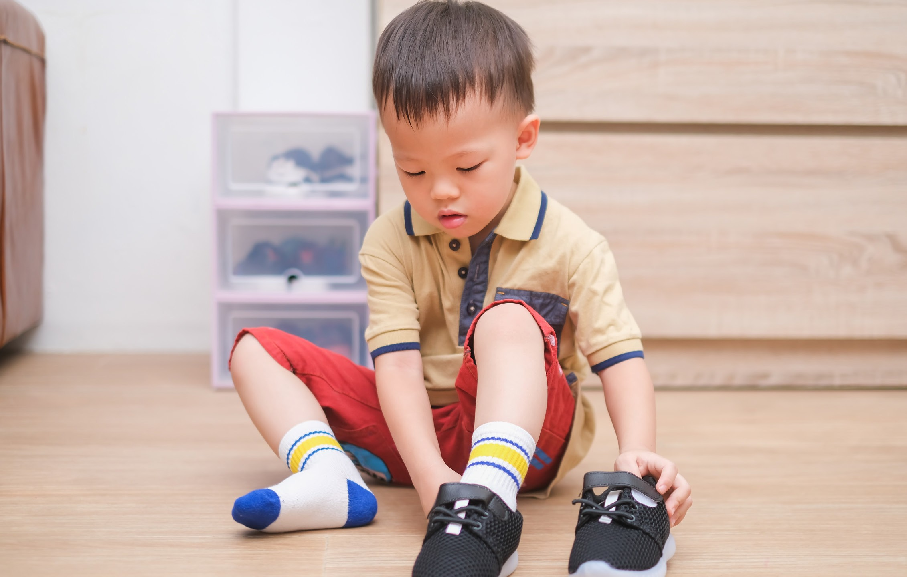
In the morning, I will take off my shoes and say good-bye.

Slide 7
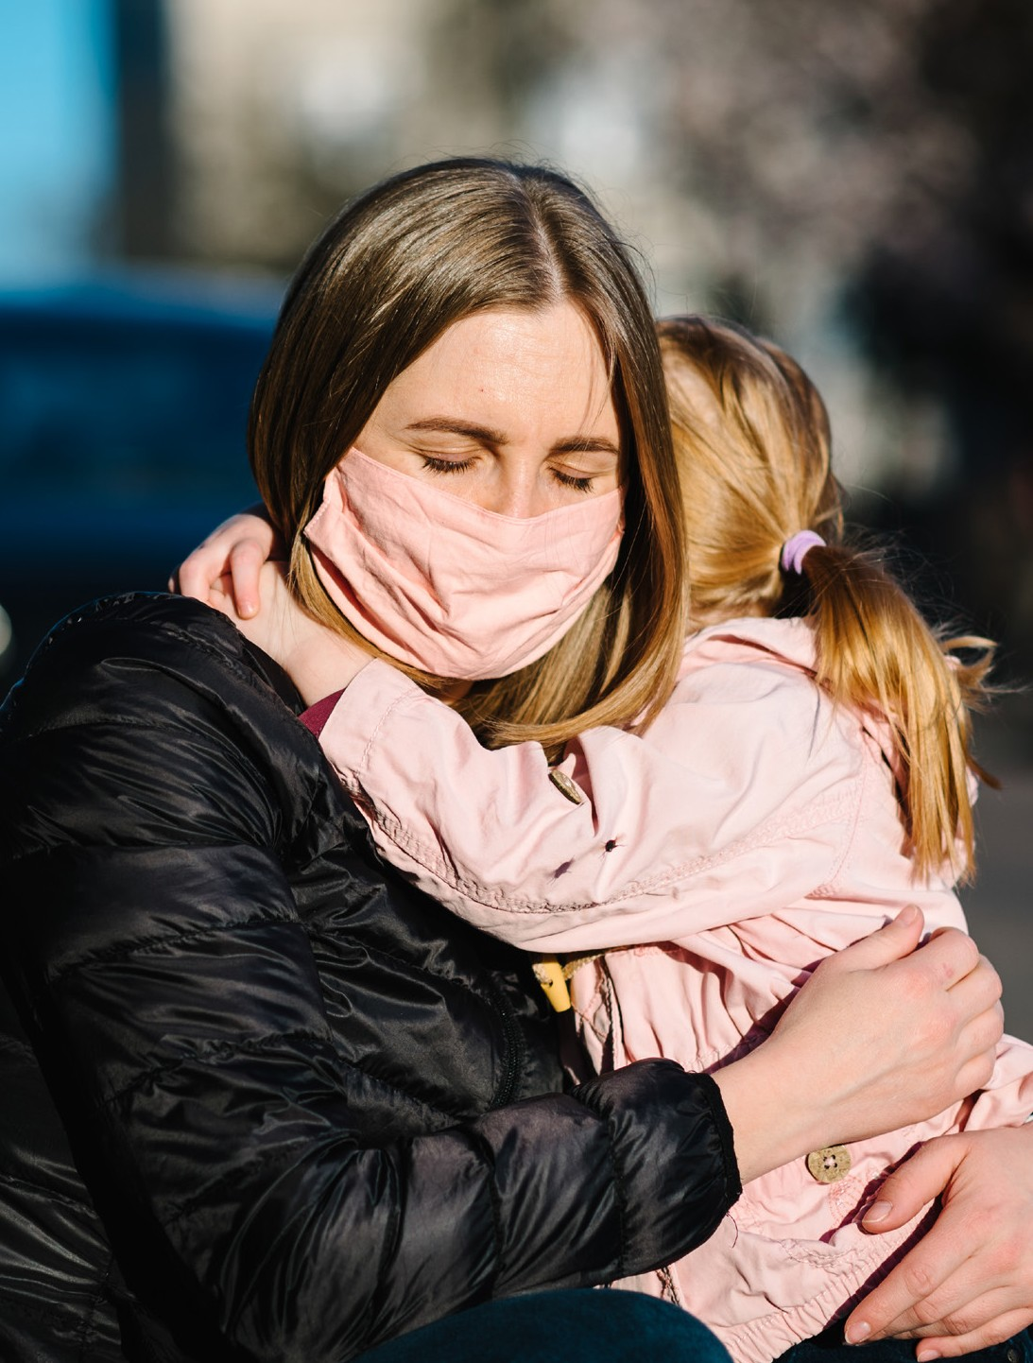
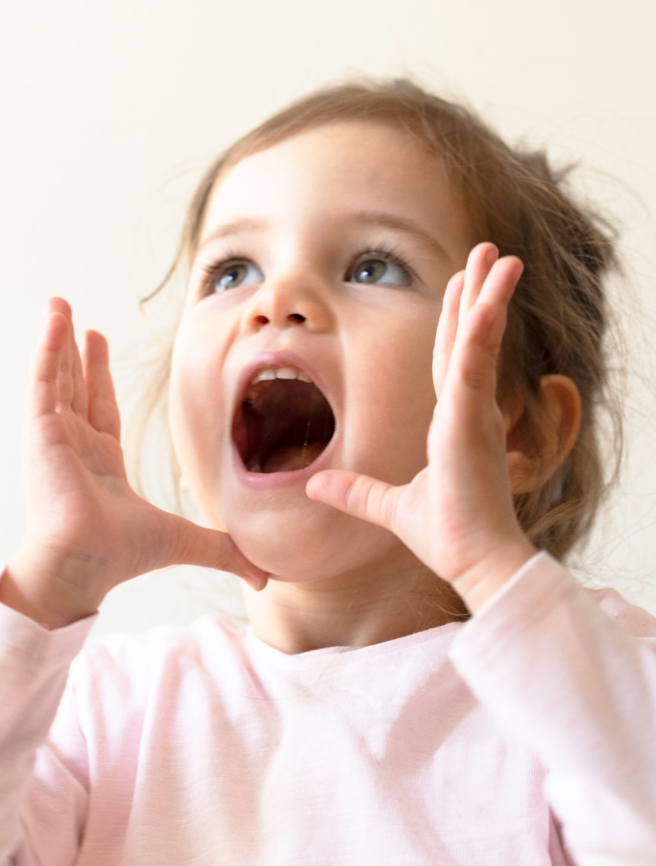
I might feel sad but
I know my caring adult will be back soon!
I am excited to see my friends.

Slide 8
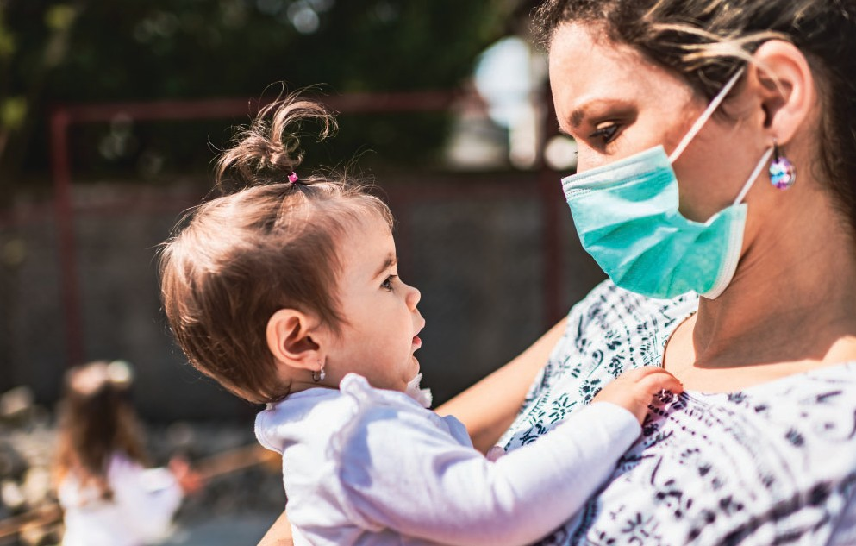
The caring adults around me might be wearing masks over their faces. They might look a little funny and different.
I know they wear masks to keep everyone safe and healthy.

Slide 9
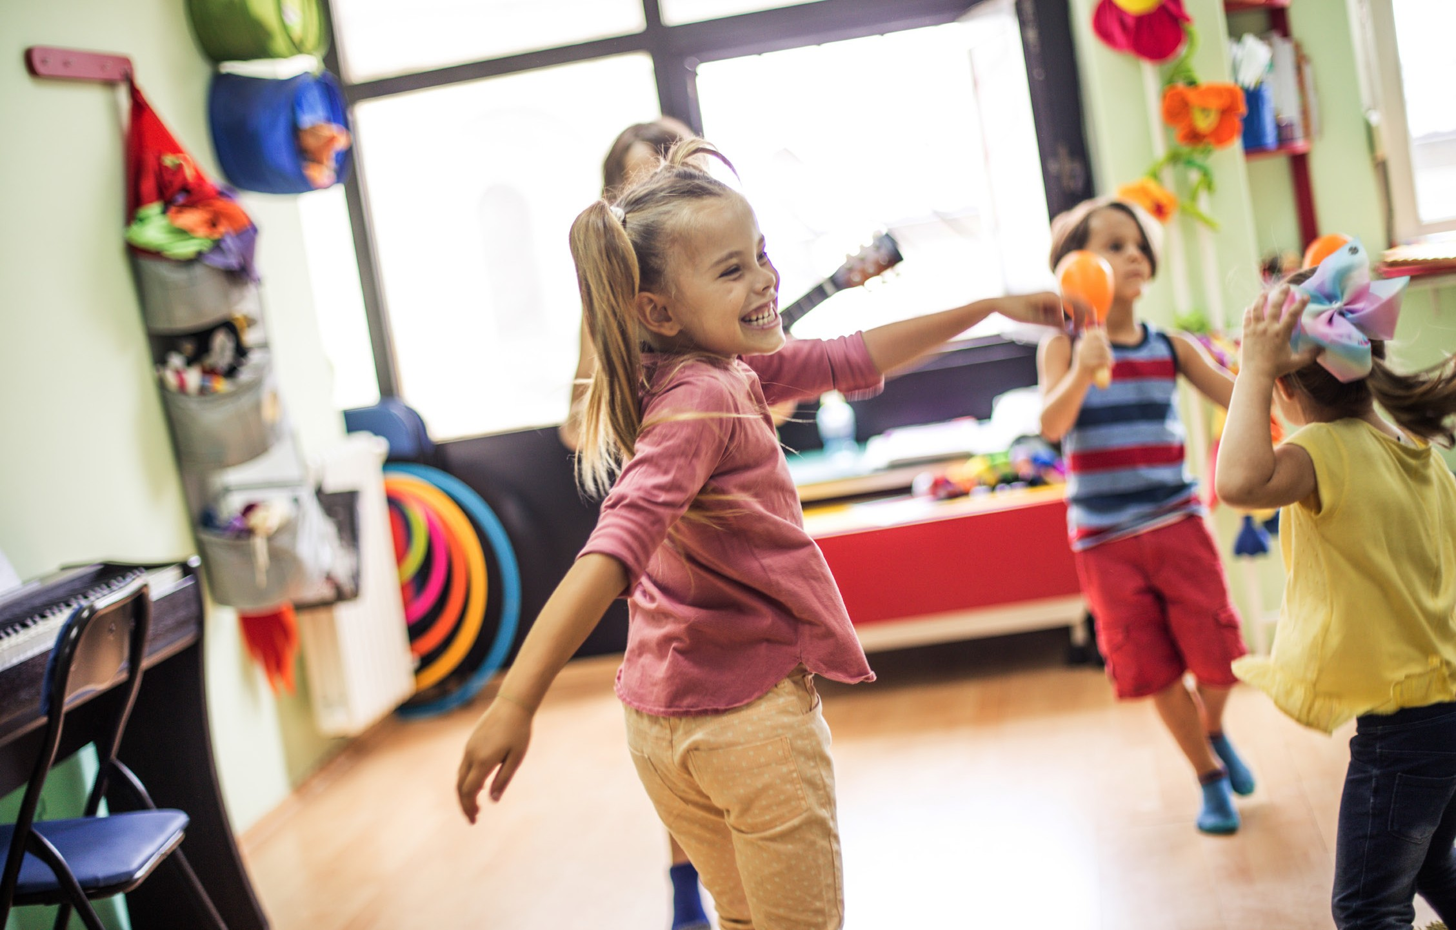
Where I play might look different.
I still play, have fun, and get to learn with lots of toys and books.

Slide 10
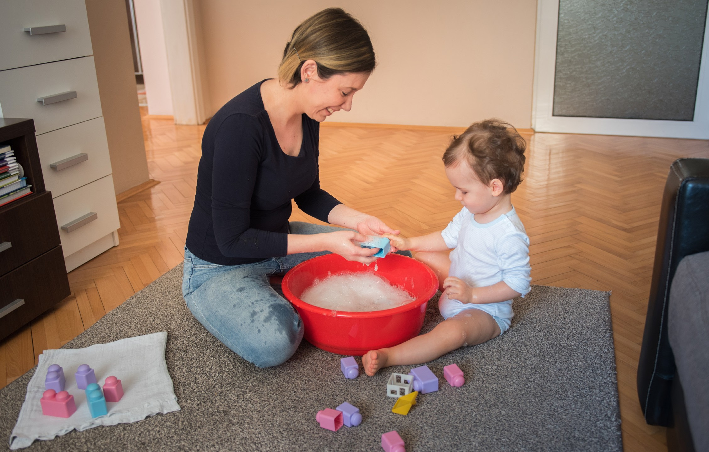
My toys might even need to get cleaned!

Slide 11
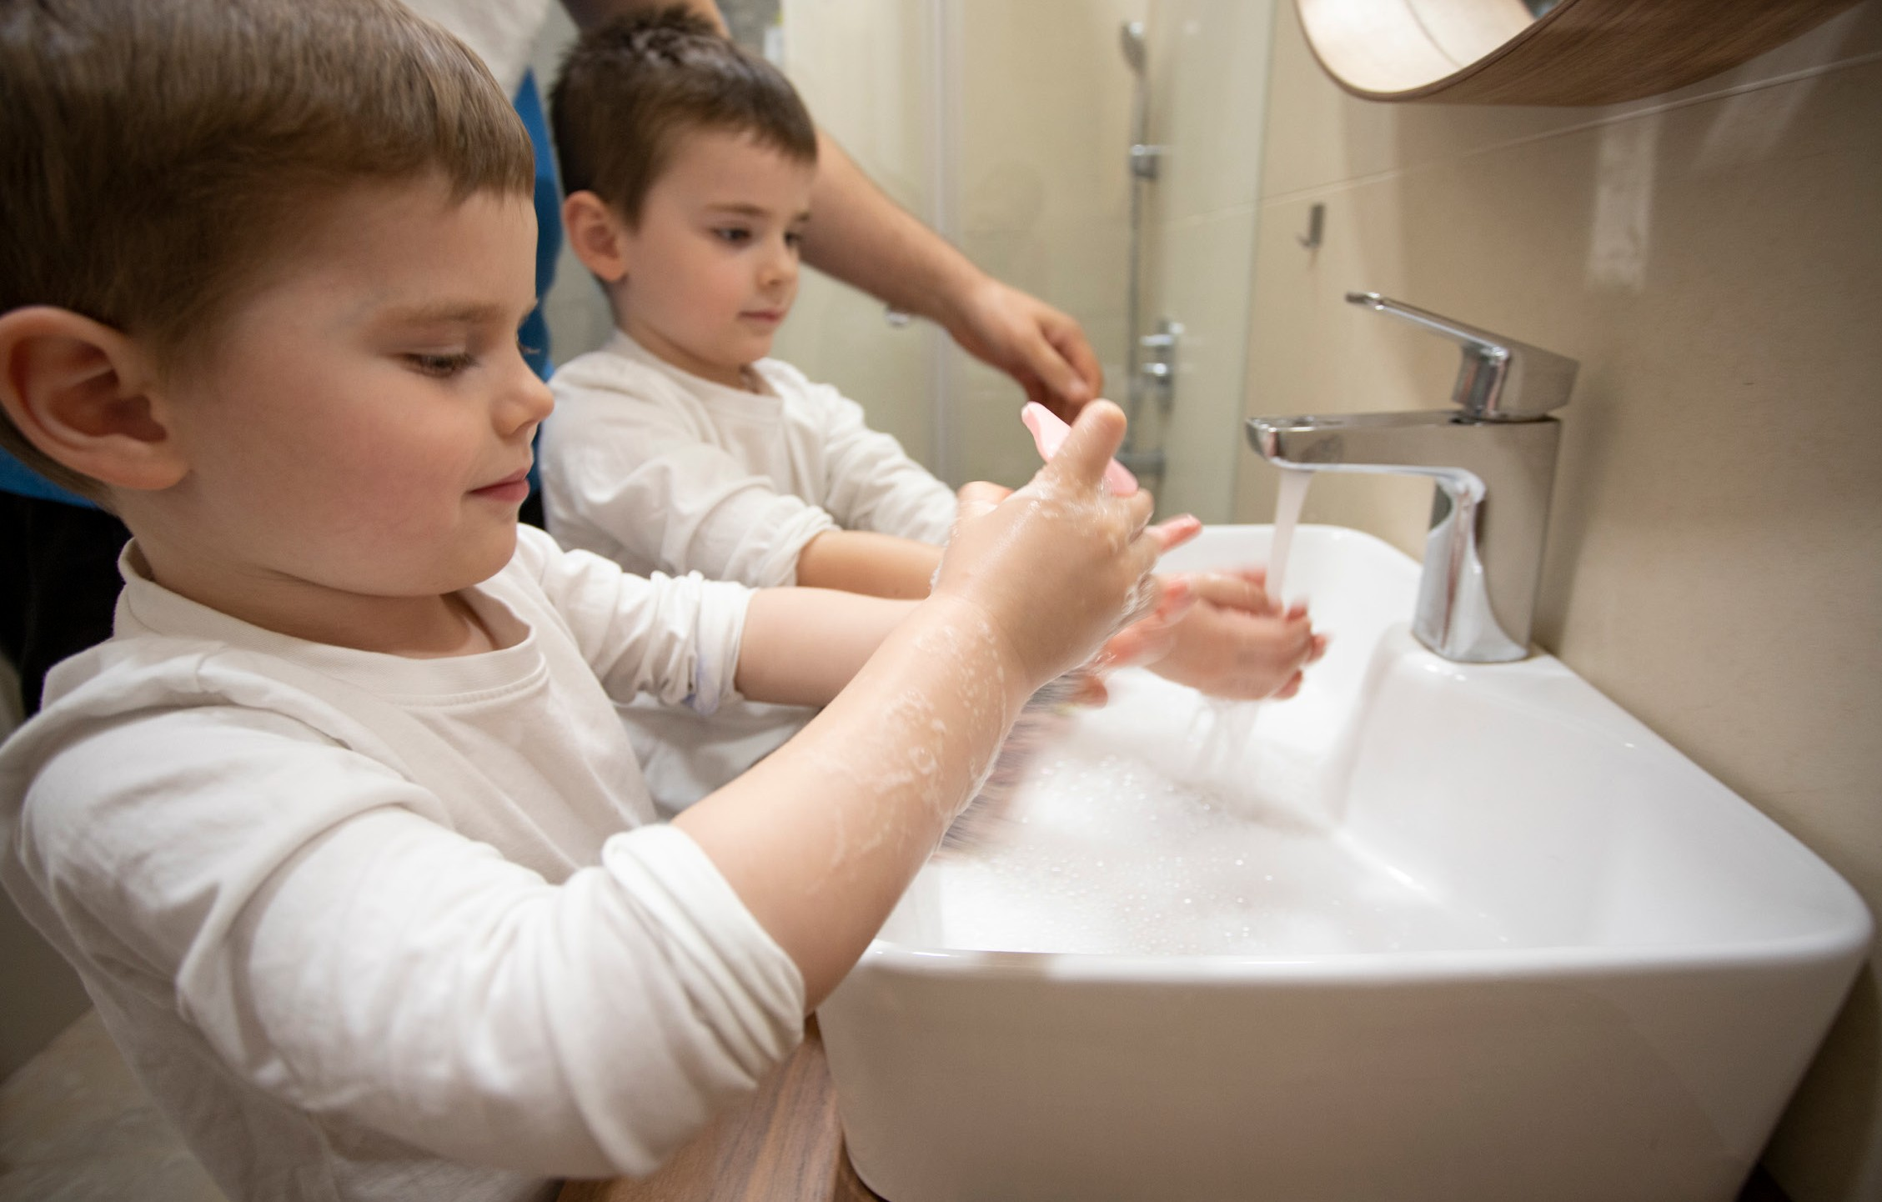
I might have to wash my hands many times a day. This is so I can stay safe and healthy and help keep others safe, too!

Slide 12

Even though things are different than they used to be, I still have lots of fun at child care.

Slide 13
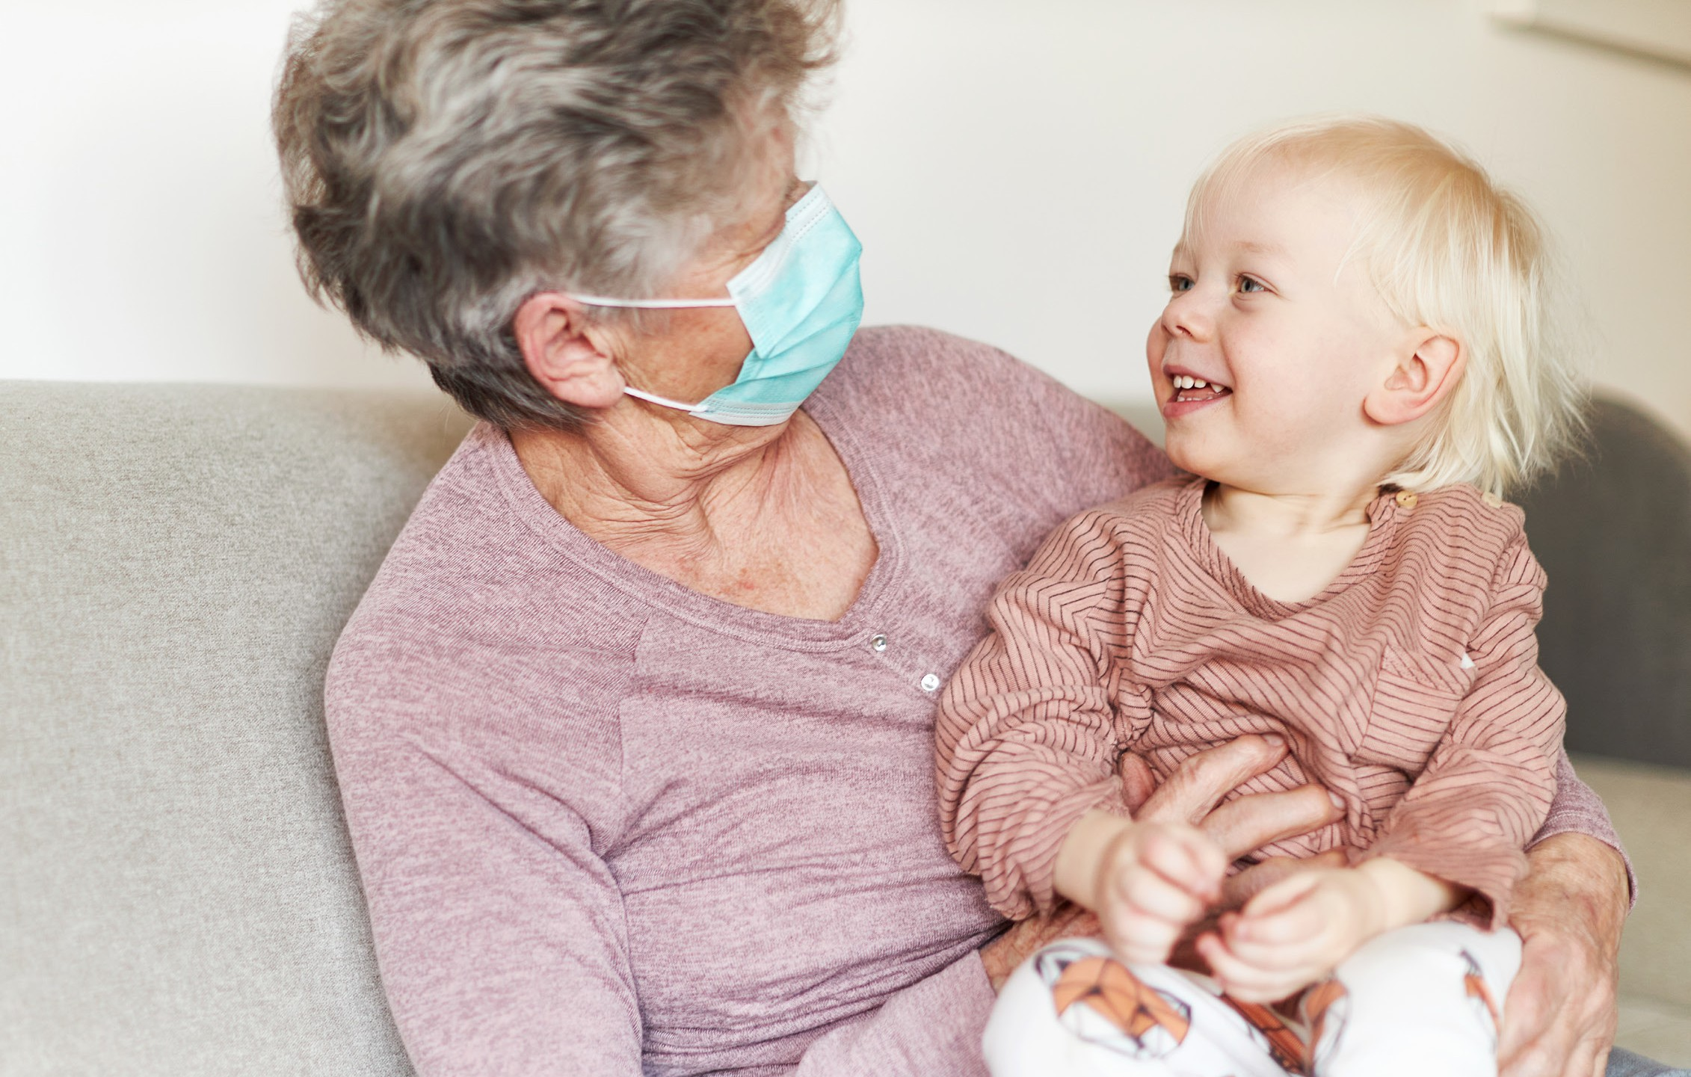
I know that everyone loves me and is doing their best to keep me and all my friends safe and healthy.

