Slide 1

A BETTER FUTURE FOR ALL CHILDREN BEGINS WITH
HELP ME GROW
Advancing Developmental Promotion
Early Detection
Linkage to Services
Holly Dingman, Children’s Hospital & Medical Center
Center for the Child & Community
Notes:
I am here to tell you about Help Me Grow and bring you in to the community roll-out of this exciting initiative.
Introduce self
Thank you….. Lincoln Littles (Suzanne & Anne); United Way (Georganne & Lynn), Community Action Partnership (Heather), CLC (Lindsay) and all of you child care providers for continuing to learn and committed to the health & wellbeing of their children.

Slide 2

What is Help Me Grow?
One Stop Shop for:
Information/Resources
Coordinated care
Empowers families to:
Celebrate their child’s development
Understand what to do if their child isn’t meeting developmental milestones
Notes:
At its heart, Help Me Grow is a parent/ caregiver information line designed to connect families to information about child development and community resources.
Goal is to break down silos, get appropriate information and coordinate care

Slide 3
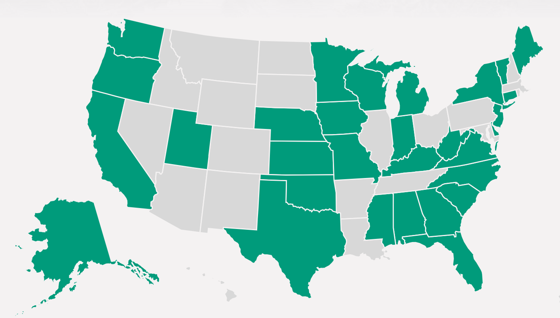
HMG System Model:
We are part of a National Network
100 Affiliates
31 states
www.Helpmegrownational.org
Notes:
Nebraska became an affiliate of the HMG Network in 2018, joining over 100 HMG affiliates across 31 states.
We recognize that Maximizing our communities’ potential starts with early childhood systems. Our goal is building connections to promote children’s optimal healthy development

Slide 4
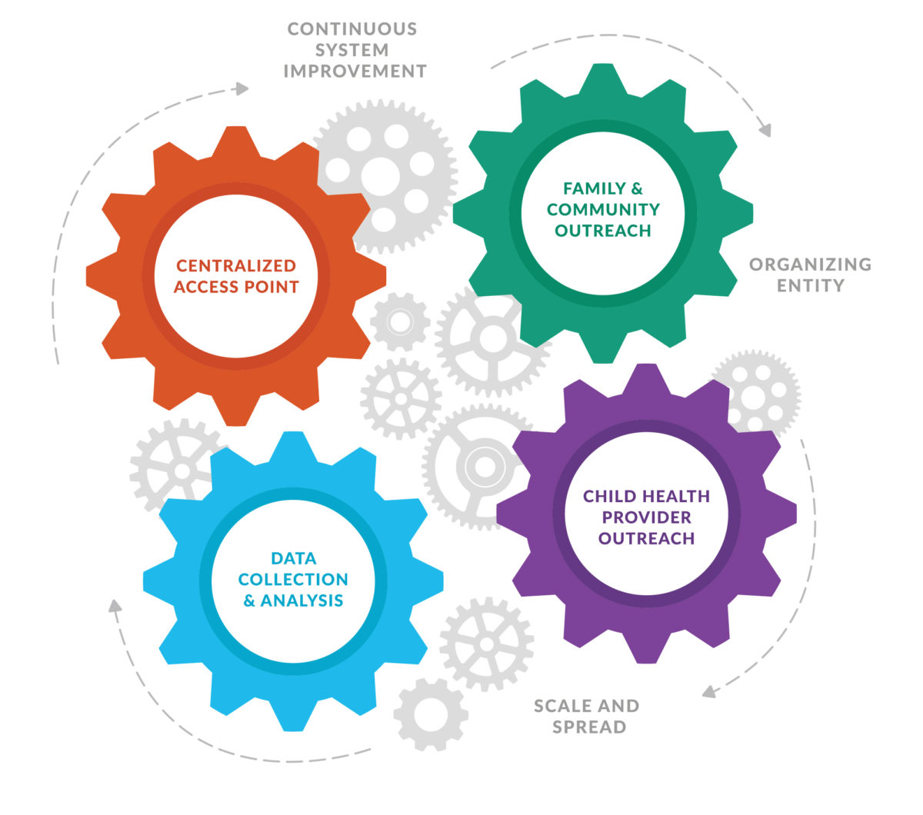
HMG System Model
(Lincoln/Lancaster Pilot)
Data Collection/Analysis:
  UNL
Provider Outreach:
  Team led by Dr. Erica Petersen
Family & Community Outreach
  Lincoln Littles – Support for Families
Centralized Access Point (CAP)
  United Way 211, UNMC Munroe-Meyer Institute, UNL’s Answers for Families
www.Helpmegrownational.org
Notes:
4 Core Components
3 structural requirements

Slide 5
Value Help Me Grow Brings to
Child Care Providers
Help Me Grow offers you and your families:
A comprehensive and current list of community resources
An easy way to connect families to programs and resources they need
More targeted supports and resources for children at-risk
Coordinated approach to child development resources
Notes:
Rick
Easy one-stop shop for you, your staff and families to get the most updated community resources & Connect families with basic needs (housing, transportation, food support).
Get resources on child development including resources related to developmental milestones, monitoring and screening. ( We are trying to bring all the organizations/efforts around child development together. (CDC, EDN, 123 Connect with Me)
Provides support and resources for children borderline or at-risk with development skills, children who may not qualify for EDN but need extra supports.

Slide 6
DEVELOPMENTAL TRAJECTORIES
Domestic violence
Inaccessible health services
“Healthy” Trajectory
Neighborhood safety and support
Quality ECE
“Ready to Learn”
Socioeconomic disparities
“At Risk” Trajectory – 30-40% of Children
“Delayed/Disordered ” Trajectory – 7-12% of Children
Medical home
Protective home environment
Parent education
Emotional health
Health literacy
Birth
Late Infancy
Late Toddler
Late Preschool
Prenatal 6 mo 12 mo 18 mo 24 mo 3 yrs 5 yrs
Early Infancy
Early Toddler
Early Preschool
Graphic Concept Adapted from Neal Halfon , UCLA Center for Healthier Children, Families, and Communities
Notes:
Sarah

Slide 7

Who does EDN serve & benefit?
Eligible infants to toddlers, Birth to age 3 who have a developmental delay or disability
Infant or toddler with the following conditions:
  Physical, Language or Cognitive delay
  Vision or hearing loss
  Chromosomal abnormalities
  Genetic or congenital disorders
  Sensory impairment
  Severe attachment disorders
Early Intervention Services:
Assistive Technology devices and services
Audiology and Vision services
Occupational and Physical therapy services
Services Coordination
Signed language and cued language services
Social Emotional supports and services
Special Instruction
Speech/Language services
  *Continuous (year round) services
  *Provided in Home and Community settings
Notes:
Sarah

Slide 8
Who does HMG serve & benefit?
All infants & children, birth to age 8
Children at risk for developmental delays or disabilities
We also serve:
  Families
  Medical providers
  Early childhood providers
  Others
Notes:
Sarah

Slide 9
Comparison between EDN & HMG
Early Development Network (EDN) | Help Me Grow (HMG)
Supports children birth to 3 | Supports children birth to 8
Provides family-centered care coordination | Provides family-centered care coordination
Services available for those with verified developmental delay | Services for those at-risk of developmental delay
*Provides Early Intervention in child’s natural environment and involves entire family | *HMG can provide family-centered care beyond age 3 to continue supporting both the child and family.
Notes:
Sarah
Describe chart…
One thing to note is that the Early Development Network provides a family-centered approach. Family is involved, services coordinator puts supports in place for ENTIRE family and services are provided in the child’s natural environment.
When a child ages out of the EDN, special education services are available. However, these are school-based services. The focus is only on the child not the entire family.
Help Me Grow can help fill the gap when families lose EDN services coordination.

Slide 10
What are your needs? Concerns?
Do you currently connect families to the EDN? Other programs?
Empower families to be involved in their child’s development and celebrate their milestones?
Conduct developmental screening?
Assist with healthcare coordination?
Notes:
Sarah

Slide 11
What Happens When you Make a Referral?

Slide 12



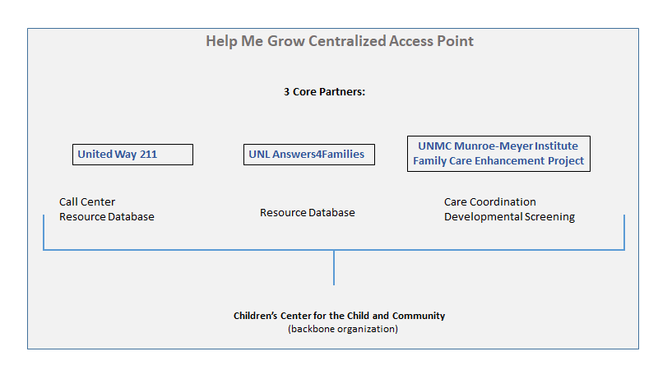

Nebraska’s Centralized Access Point
Notes:
Our CAP Team in Nebraska consists of United Way of the Midland’s 211, UNL’s Answers4Families program, and UNMC Munroe-Meyer Institute’s Family Care Enhancement Program and Children’s Hospital is the Backbone organization supporting this program. 211 offers an 800 number that anyone can call and our CAP team works together to put supports and services in place for children and families. Our goal is to coordinate care and break down silos.
Heard from Lynn & Georgann – important roll of UWM – Community Response & other support programs
Breakdown silos

Slide 13
Contact 211 to submit a referral to Help Me Grow
Any provider, parent, or caregiver is welcome to dial 2-1-1 and ask any question they might have about:
  Basic Needs; food, clothing, shelter, etc.
  Child development, parenting, etc.
  Existing Community Resources
  Care Coordination
  Quality Childcare
Referrals may be submitted online, via email or by phone or fax.
Notes:
Robyn
The process starts with 211. The Navigator listens to the needs. Families or professionals that have questions or need connected to basic needs will be helped right there. Families or professionals that need other resources (child development, care coordination, etc.) will assisted by one of our partners at the UNMC Munroe-Meyer Institute or UNL’s Answer’s for Families.

Slide 14

Recap:
EDN
HMG
Anyone may make the referral to EDN by calling statewide toll free 888-806-6287
or the local EDN office at: www.edn.ne.gov
Anyone may make the referral to HMG by:
  submitting a referral form
  calling 2-1-1 and asking for Help Me Grow
  Go to: www.helpmegrownebraska.org
Notes:
Sarah
Let’s recap.
If you already have a system in place to make EDN referrals, we want those to continue. However, we also ask that you make a referral to Help me Grow at the same time. Often times providers want to know the outcome of the Edn referral and/or want to put other supports in place. We can assist with that.
Remember, EDN is for children birth to 3. HMG is for children birth to 8.

Slide 15
What happens with a referral?
EDN
HMG
Services Coordinator will contact family within 7 days to set up a home visit
The school district is immediately notified
Evaluation of child by school district trained professionals
Evaluates developmental strengths/needs in:
  Cognitive
  Motor Development
  Communication Skills
  Social/Emotional Development
  Self-help skills
  Mandated Timelines
    45 calendar days from referral date to evaluation
Individualized Family Service Plan is created and family driven
HMG Navigator, 211
  Referral intake
  Triages referral to determine:
    SDoH needs
    Development/Parenting support needs
MMI’s Parent Resource Coordinators (PRC’s)
  Peer-to-peer support and assistance to families that have children with disabilities or special needs
  Provide navigational supports
  Conduct developmental screening
  UNL Answers for Families
  Connect with community resources
Notes:
Sarah & Robyn
The Help Me Grow CAP partners will work together to put supports in place

Slide 16
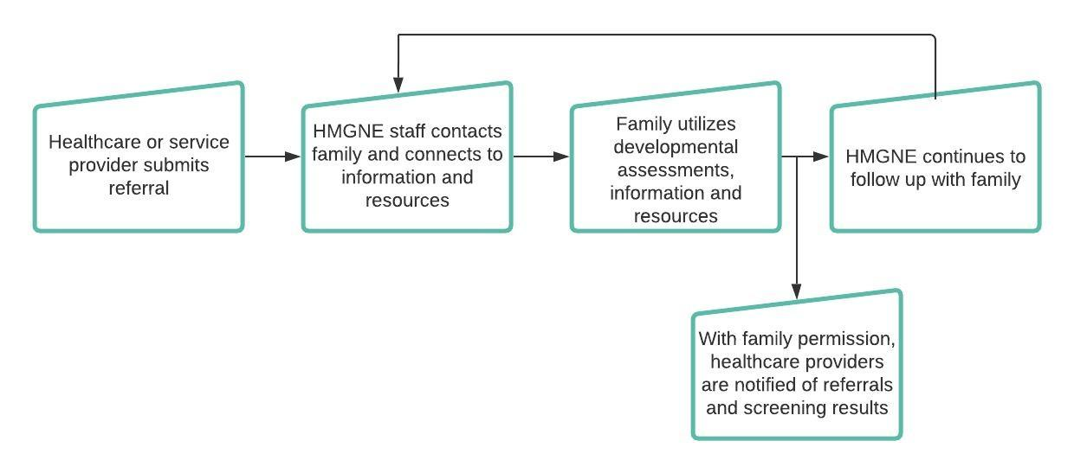
HMG Referrals
Childcare
Childcare
Families sign your Consent & Authorization Form
Notes:
Robyn

Slide 17
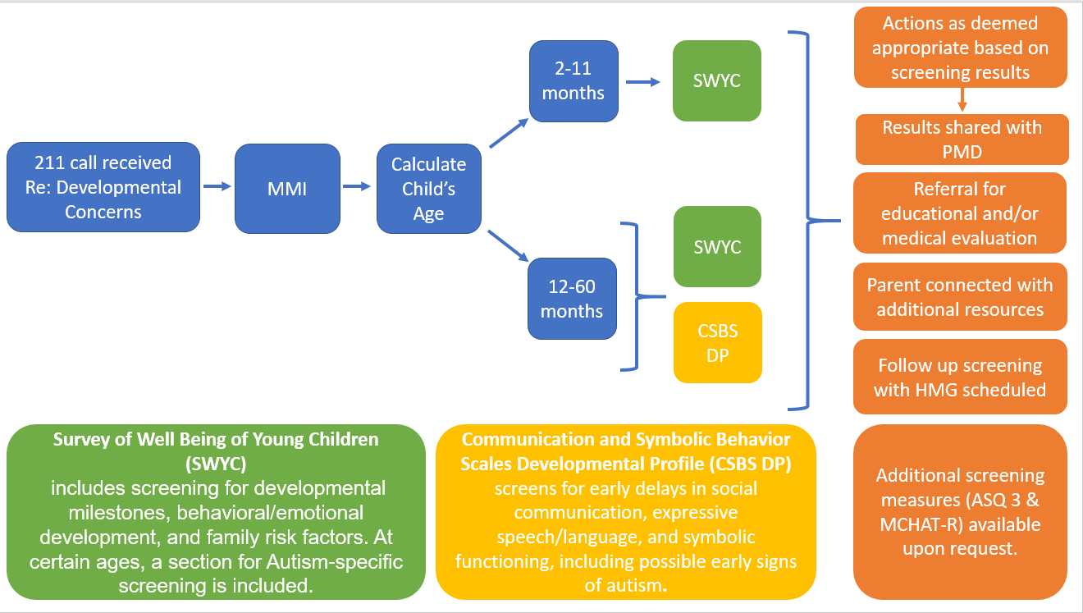
HMG Developmental Screening Tools and Process
Notes:
Sarah
If it’s been determined that there needs to be a developmental screening conducted, one of our Parent Resource Coordinators have been trained to do so.

Slide 18
How do I know if a family is helped?
If a consent/authorization form is signed, HMG will share information back with the child care provider
Once a referral is completed, the HMG Navigator will follow up with the parent or guardian to determine if:
  Their needs were met
  There are unmet needs resulting in the referral being reopened
  A new referral is needed
Notes:
Sarah
If a consent/authorization form is not signed, HMG will work directly with the parent or guardian and will be unable to share information with the provider

Slide 19
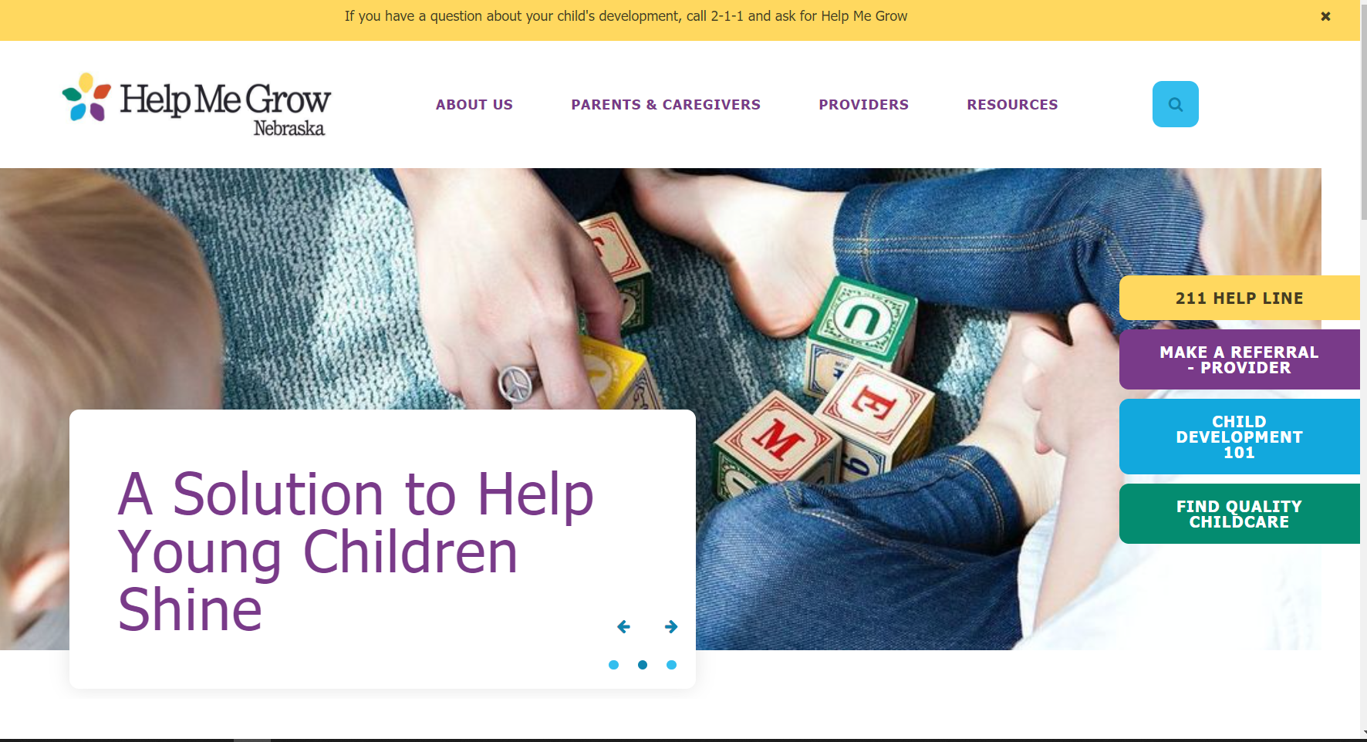

Slide 20

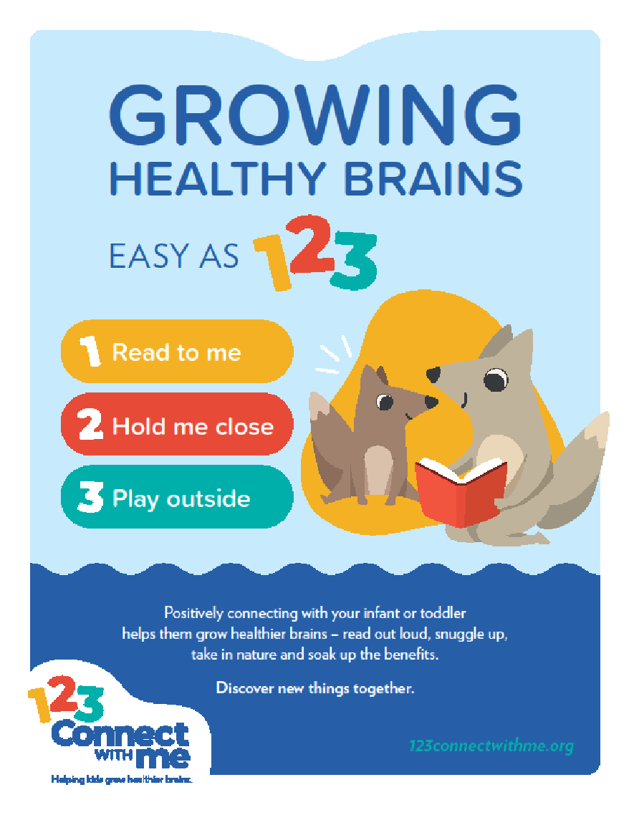
123connectwithme.org
Notes:
The three themes for this Connect Kit are Read to me, Hold me close and Play outside.

Slide 21


Storyland Exhibit
Lincoln Children’s Museum June-September
Immersive experience bringing popular story books to life and educating parents how to support continued learning at home
Target Audience: Children 0-8 years old, families and school groups
Exhibit includes:
  The Tale of Peter Rabbit by Beatrix Potter
  The Snowy Day by Ezra Jack Keats
  Where’s Spot? by Eric Hill
Notes:
Tara

Slide 22
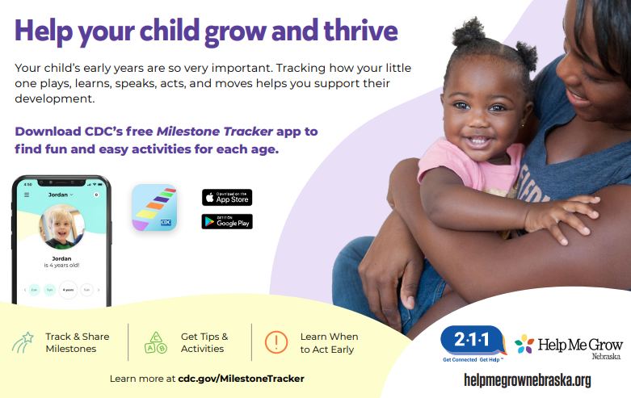

Slide 23


Questions?
Advancing Developmental Promotion
Early Detection
Linkage to Services
Contact Rick Helweg @ rhelweg@childrensomaha.org

