Slide 1
Half Hidden: A Book to Help Children Decipher Emotions Beneath the Mask
Created by
Diana Shaw, LMHP, RPT and Michelle Halpine

Slide 2
Background Information
Humans are wired to have relationships and seek social connections. The human face is a portal into the world of others. In fact, the face is so interesting that just 9 minutes after birth, newborn babies prefer to look at faces than any other object.
Although the age at which babies begin mirroring caregivers’ expressions is widely disputed as of late, what is clear is that they are tuned in to the expressions they’re seeing.
Reading facial cues has a basis in survival. The emotional expression of others gives us important clues about what’s going on around us.
Studies have shown cultural differences in both how emotions are displayed as well as how they are interpreted. One study showed that Americans tend to look at the mouth, while Japanese participants looked at the eyes to decipher what another person was feeling.
Morton, J., and Johnson, M. H. 1991. CONSPEC and CONLERN: a two-process theory of infant face recognition. Psychol. Rev. 98(2):164–81.
Yuki, M., Maddux, W. W., and Masuda, T. 2007. Are the windows to the soul the same in the East and West? Cultural differences in using
the eyes and mouth as cues to recognize emotions in Japan and the United States. J. Exp. Soc. Psychol. 43(2):303–11.

Slide 3
Caregiver Instructions
The recent addition of masks to our daily wardrobe begs the question of how children are going to understand facial expressions and associated social-emotional content.
Use this tool to have conversations with children about what different emotions may look like under a mask.
Instructions
Read the feeling word on each page
Start with the image on the left-hand side
Discuss information about what each emotion looks like above the mask (i.e. forehead, eyebrows, eyes, and nose)
Move to the image on the right-hand side, noting what lower face components complete the emotion expression
Subsequent times going through the book, mix things up.
Go through the book in a different sequence
Use construction paper to cover the word and unmasked image, and then have the child(ren) describe what they see and which emotion they believe it to be.

Slide 4
Extension Ideas
Have the child reading the book make the expression on each page. Compare using a mirror. Then have the child put their mask on and do the same thing.
Put a mask on and have the child guess what expression you are emoting beneath it.
Have the child put on a mask and play the guessing game.
Discuss why the child on each page might be feeling that way.
Have child(ren) tell a time they felt the feeling on the page.
Describe how you are feeling frequently throughout the day, particularly if your mask is on.
Frequently discuss the physical components of emotional expression by others throughout the day, particularly in a classroom setting. This will assist young children in developing facial recognition skills more rapidly.
Go to the following link and test your own facial decoding skills: http://socialintelligence.labinthewild.org/mite/

Slide 5
HAPPY

Slide 6
SAD

Slide 7
SILLY

Slide 8
LOVED

Slide 9
SCARED

Slide 10
SURPRISED

Slide 11
MAD

Slide 12
BORED

Slide 13
FRUSTRATED

Slide 14
EXCITED

Slide 15
Mask Activity
Laminate the following pages.
Laminate and cut out the mask template on the last page.
Add Velcro to the mask and corresponding faces (near the nose of each face works well).
To use:
Encourage children to put-on and take-off the mask for each visual. This activity helps normalize mask wearing.
Caregivers can support emotion learning by asking questions about the faces and what the child in the picture might be feeling. Point out eyes and eyebrows. Example: Mad photo: “notice his eyes are closed and there are lines on his forehead”. “How do your eyes look when you are mad”? “This is how my eyes look” (perhaps add a mirror for the child to look into when practicing faces with mask).
This visual could be posted on the wall or bound together as a book.

Slide 16
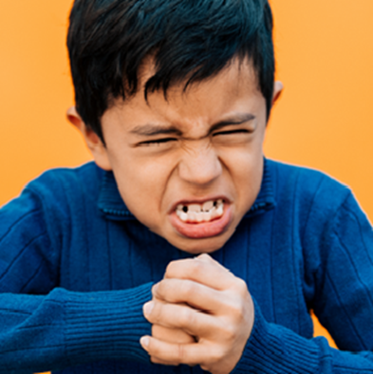
Mad

Slide 17
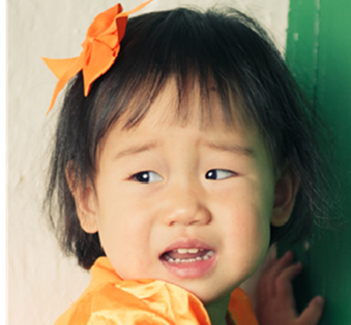
Scared

Slide 18
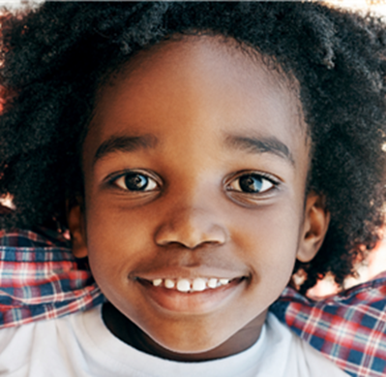
Happy

Slide 19
Frustrated

Slide 20
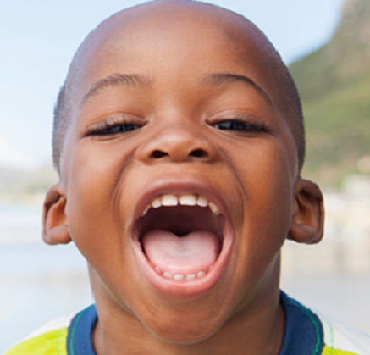
Excited

Slide 21
Place your own picture here
(add additional slides for other caregivers or children known to the child or class)

Slide 22
For additional support on using this book or KidSquad services please contact Jana Habrock, KidSquad Coordinator jhabrock@childsaving.org
The services provided by KidSquad are supported in part through a grant provided by the Nebraska Early Childhood Collaborative, United Way of the Midlands, anonymous donors, and through federal award G1601NECCDF of the Childcare and Development Block Grant of the US Department of Health and Human Services.

Slide 23
TEMPLATE
Cut out mask
Laminate
Velcro

