Slide 1
Our Calming Corner
The reproduction of this document is encouraged.
Permission to copy is not required and it may be modified to meet your needs.

Slide 2
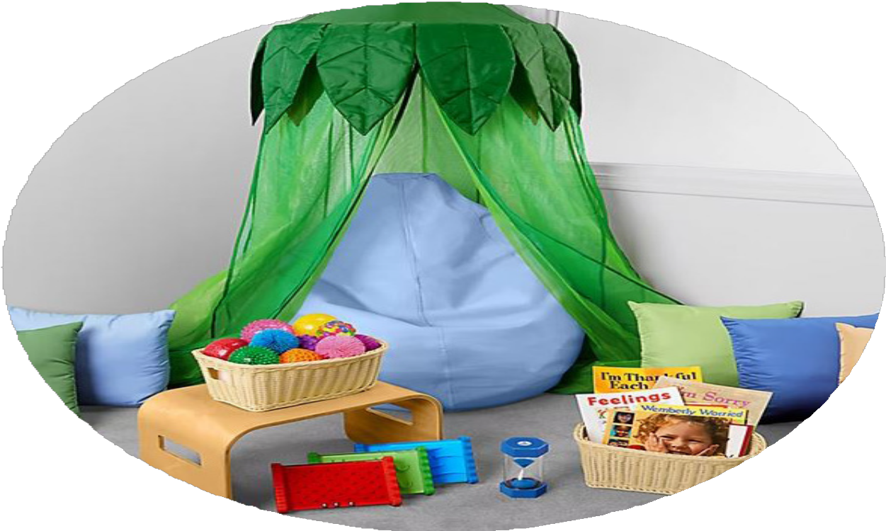
Our Calming Corner!

Slide 3
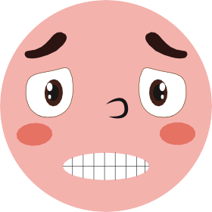
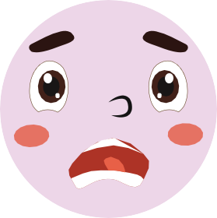
Everybody has feelings.
What feelings can you name?
HAPPY
NERVOUS
JEALOUS
ANGRY
SICK
EXCITED
SCARED
TIRED
SAD
CRY

Slide 4
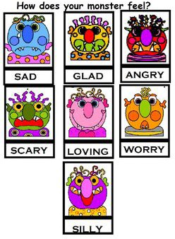
Sometimes we have really big feelings.
Like when we are really mad, sad, or disappointed.

Slide 5
Everyone has BIG feelings!
BIG feelings are OK!

Slide 6
Our Calming Corner is a great place to go when you have big feelings!

Slide 7
In our Calming Corner, when you have big feelings, you can read a book...

Slide 8
Take deep breaths...

Slide 9
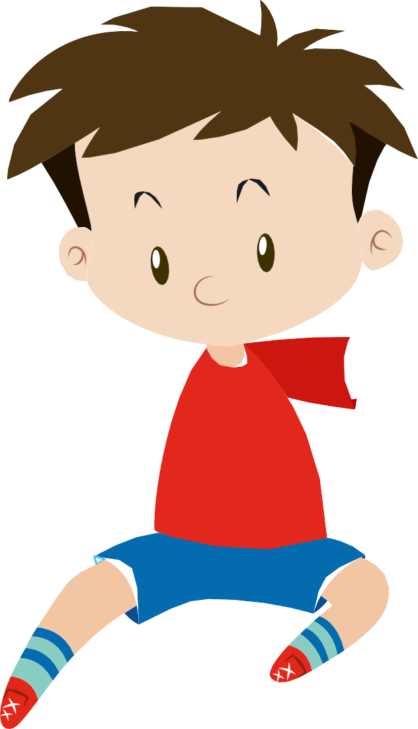
or even just sit and play quietly with toys.

Slide 10
You can ask an adult to
please help or join you if you want to.

Slide 11
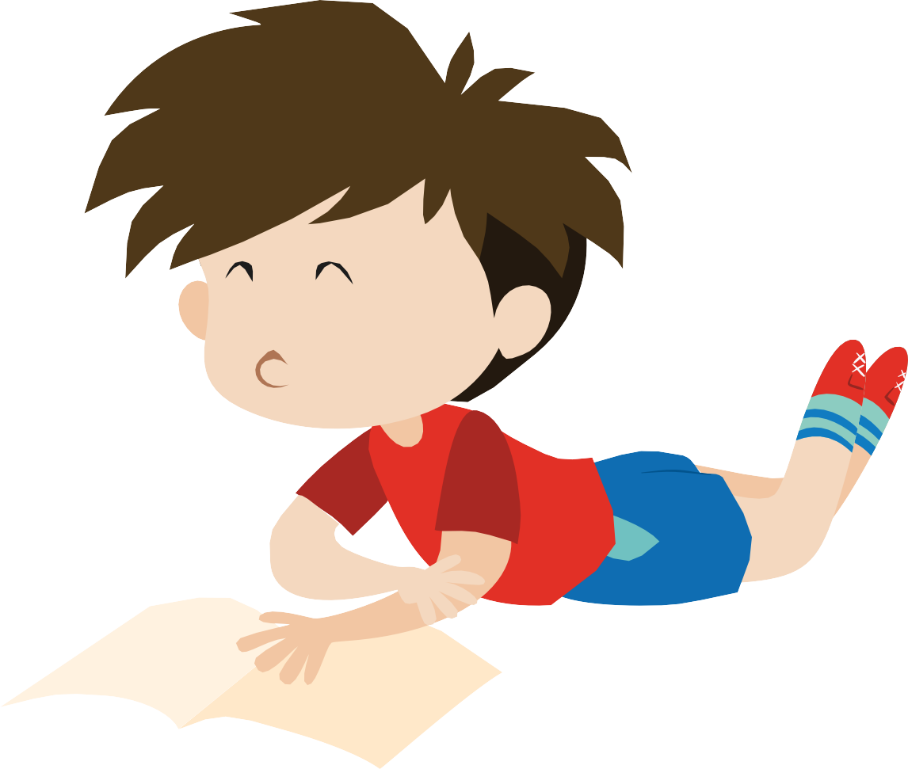
You can stay in the Calming Corner as long as you need.

Slide 12
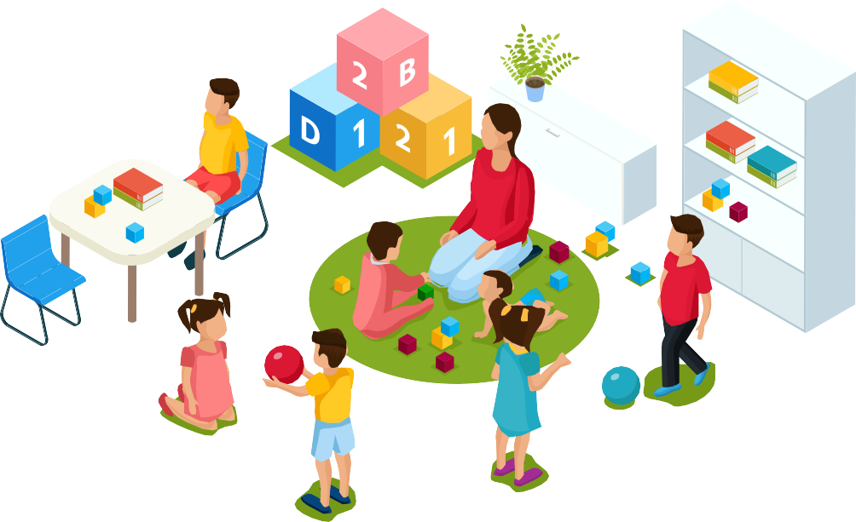
And when you are ready, come back to play with your friends!

